Slide 1

Notes:
1st slide (Mandatory)

Slide 2
Average

Slide 3
Average
The average is defined as the mean value which is equal to the ratio of the sum of the number of a given set of values to the total number of values present in the set.
Average = Sum of Values/Number of Values

Slide 4
Average Questions
The average of the first 100 positive integers is:
100
51
50.5
49.5
Notes:
Ans: Option ( c )

Slide 5
2. The average of 37 consecutive number is 54. The largest of these number is:
74
73
72
71
Notes:
Ans: option ( c )

Slide 6
3. If average of 14 consecutive even numbers is 107. Then find the smallest number?
93
94
92
89
Notes:
Ans: option ( B )

Slide 7
4. If A is 1/6 of C, and B is twice of A, and the average of A,B and C is 30, then difference between A and C is:
40
60
80
50
Notes:
Ans: option ( d )

Slide 8
5. In a class of 180 students, 45% are girls and the remaining are boys. If the average of the girls’ marks is 54 and that of the boys is 46, What is the average of the whole class?
49.6
49.8
49.7
49.5
Notes:
Ans: option ( a )

Slide 9
6. In a class of 60 students, 40% are girls. The average eight of the whole class is 59.2kg and the average weight of the girls is 55kg. What is the average weight of the boys?
63
60
61
62
Notes:
Ans: option ( d )

Slide 10
7. The average height of 5 boys is 175cm. A sixth boy joined the group now increased by one centimeter. The height of the sixth boy is:
180cm
181cm
179cm
175cm
Notes:
Ans: option ( b )

Slide 11
8. The average age of 25 men is 28 years. 5 new men of an average age of 25 years joined them. Find the average of all the men together.
29.5 years
26.5 years
27.5 years
28.5 years
Notes:
Ans: option ( c )

Slide 12
9. Out of four number the average of the first three is 26 and that of the last three is 24.5. If the last number is 19, then find first number?
24.5
23.5
25
25.5
Notes:
Ans: option ( b )

Slide 13
10. The average salary of a person for the months of February, March, April and May is Rs.12,000, and that for the months March, April, May and June is Rs.3,000. If his salary for the month of June is Rs.6,000, then What is his salary for the month of February?
4,200
5,500
4,500
5,000
Notes:
Ans: option ( a )

Slide 14
11. The average marks of 50 students in an examination was 65. It was later found that the marks of one student had been wrongly entered as 83 instead of 38. The correct average is?
63.9
64.5
64.7
64.1
Notes:
Ans: option ( d )

Slide 15
12. The average marks of 40 students was found to be 68. If the marks of two students were incorrectly entered as 48 and 64 instead of 84 and 46 respectively, then what is the correct average?
68.15
68.25
68.35
68.45
Notes:
Ans: option ( d )

Slide 16
13. The average of the marks of 30 boys is 88, and when the top two scores were excluded, the average marks reduced to 87.5. If the top scores differ by 2, then the highest mark is:
90
94
92
96
Notes:
Ans: option ( d )

Slide 17
14. A batsman scores 92 runs in his 15th innings, which increases his batting average by 4. What will be his batting average after the 15th innings?
32
36
40
35
Notes:
Ans: option ( b )

Slide 18
15. The average run of a batsman in his 23 matches is 62. He scores 122 in his 24th match. Find his new average.
64.5
63
62.5
65
Notes:
Ans: option ( a )

Slide 19
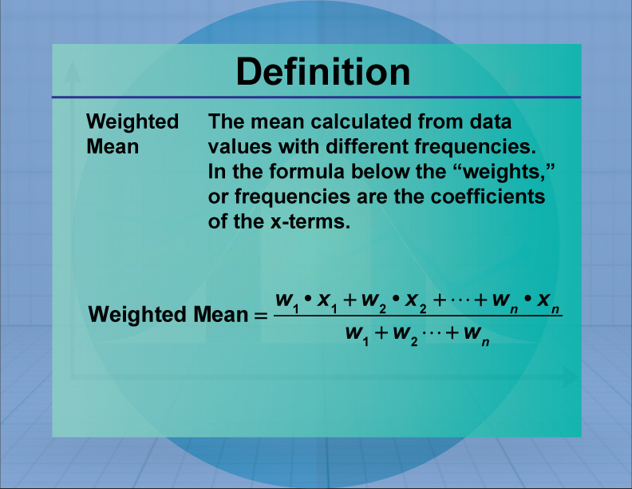
WEIGHTED AVERAGE

Slide 20
A library has an average of 265 visitors on Sundays and 130 visitors on other days. The average number of visitors per day in a month of 30 days beginning with a Monday is:
148
135
165
129
Notes:
Ans: option ( a )

Slide 21
2. In a class of 80, 60% participate in games and the rest do not. The average weight of the former group is 5% more than that of the latter. If the average weight of all the student is 51 ½ , then what is the average weight (in kg) of the former group?
57.6
54.5
60
52.5
Notes:
Ans: option ( d )

Slide 22
3. The average score in Mathematics of 90 students of section A and B of class IX was 63. The number of students in A were 10 more than those in B. The average score of students in A was 30% more than that of students in B. The average score of students in B is:
60
54
50
56
Notes:
Ans: option ( b )

Slide 23
4. The average of n numbers is 58. If each of 65% of the numbers is increased by 16 and each of the remaining number is decreased by 9, then the new average of the number:
67.125
64.75
65.25
66.5
Notes:
Ans: option ( c )

Slide 24
5. In VIT college in B.Tech, ECE branch there are three sections A,B and C. If number of students in section A, B and C are 95,209 and 171 respectively and the average marks of section A,B and C in an exam are 83,78 and 85 respectively. What is the average marks of ECE branch?
80.66
81.52
81.4
82.16
Notes:
Ans: option ( b )

Slide 25
THANK YOU

